Slide 1




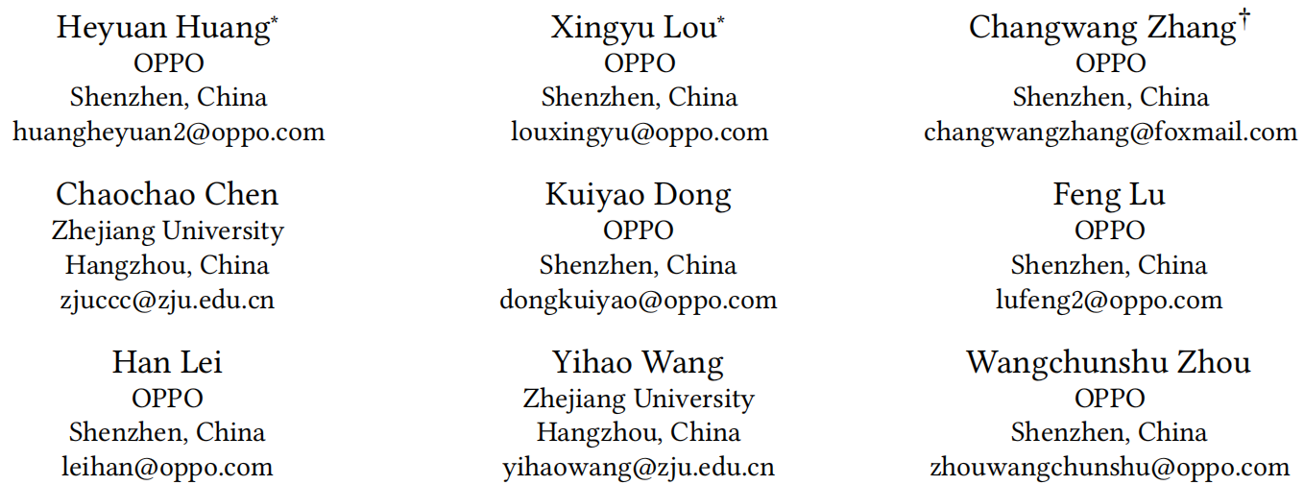





ATAI
Advanced Techniqueof Artificial Intelligence
ATAI
ChongqingUniversity _{AdvancedTechniqueof}
of Technology Artificial Intelligence
Chongqing University of
Technology
Chongqing University ^{ATAI}
_{of Technology} Advanced Techniqueof
Artificial Intelligence
Chongqing University of Technology
Chongqing University of Technology
Training-free Periodic Interest Augmentation in
Incremental Recommendation
Code:None
2025.10.9 •ChongQing
—— SIGIR_2025
Reported by Lele Ren
1

Slide 2

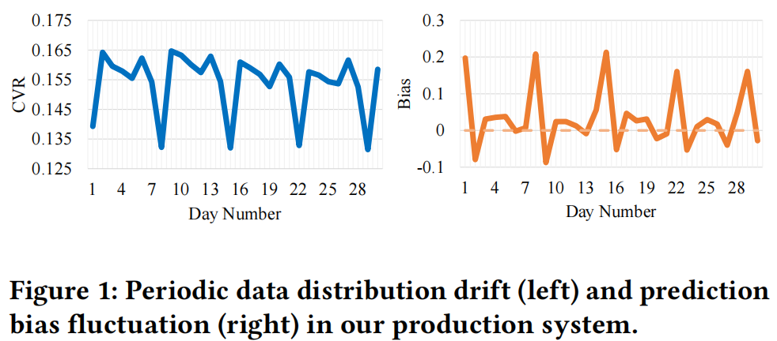
ChongqingUniversity of Technology
ATAI
AdvancedTechniqueof
Artificial Intelligence
ATAI
ChongqingUniversity _{AdvancedTechniqueof}
of Technology Artificial Intelligence
Motivation
（1）Continuous updates in recommendation systems are prone to overfitting current data and, due to the inability to adapt to users' periodic interests, cause periodic data distribution drift, leading to prediction bias.
（2）Existing methods, when utilizing interests, either suffer from overfitting due to periodic interests masking recent interests or face inefficiency from the need to retrain historical data or retain additional parameters.

Slide 3

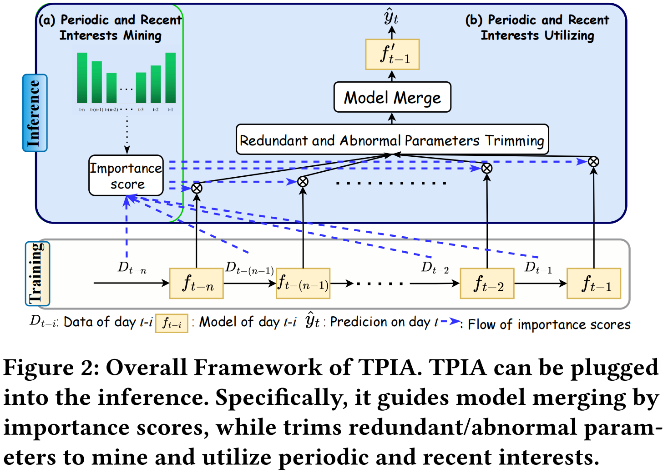
ChongqingUniversity of Technology
ATAI
AdvancedTechniqueof
Artificial Intelligence
ATAI
ChongqingUniversity _{AdvancedTechniqueof}
of Technology Artificial Intelligence
Overview

Slide 4

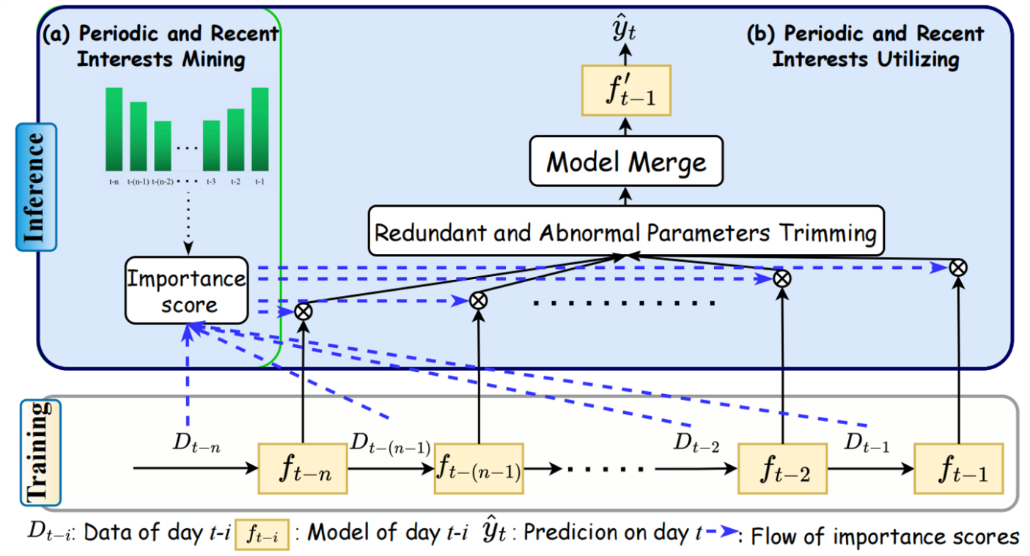


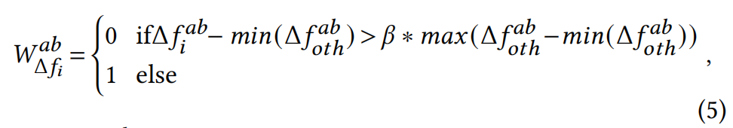
ChongqingUniversity of Technology
ATAI
AdvancedTechniqueof
Artificial Intelligence
ATAI
ChongqingUniversity _{AdvancedTechniqueof}
of Technology Artificial Intelligence
Method

Slide 5

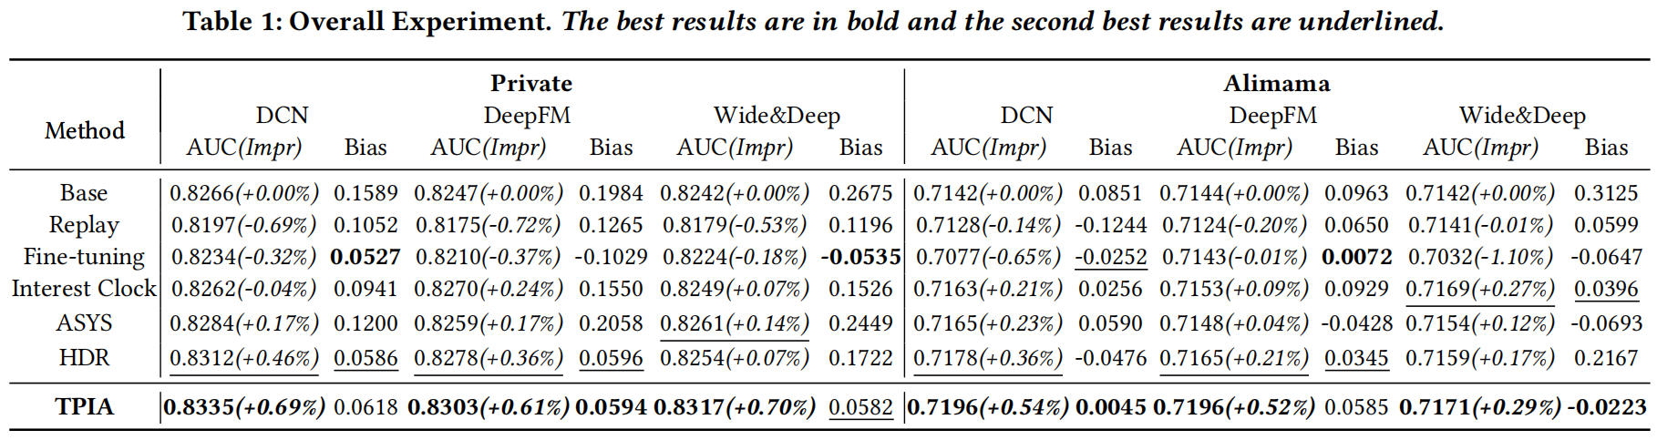
ATAI
AdvancedTechniqueof
Artificial Intelligence
ATAI
ChongqingUniversity _{AdvancedTechniqueof}
of Technology Artificial Intelligence
ChongqingUniversity of Technology
Experiments

Slide 6
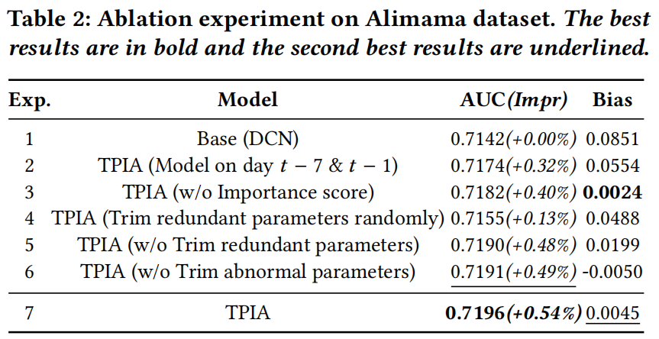
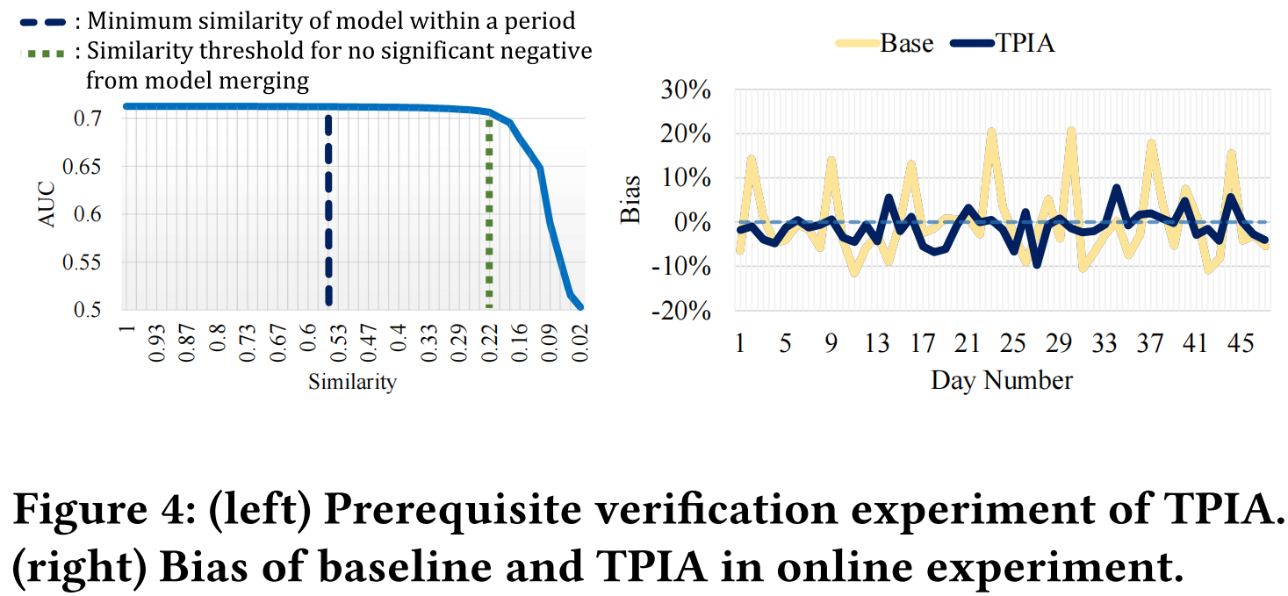
ATAI
AdvancedTechniqueof
Artificial Intelligence
ATAI
ChongqingUniversity _{AdvancedTechniqueof}
of Technology Artificial Intelligence
ChongqingUniversity of Technology
Experiments

Slide 7


ChongqingUniversity of Technology
ATAI
AdvancedTechniqueof
Artificial Intelligence
ATAI
ChongqingUniversity _{AdvancedTechniqueof}
of Technology Artificial Intelligence
Thanks!

